Slide 1
PNEUMONIA OTHER THAN TB
Presenters
1. Dr Shadai Ndandala
2. Dr James Masanja
Facilitator
Dr Sibtain Moledina

Slide 2
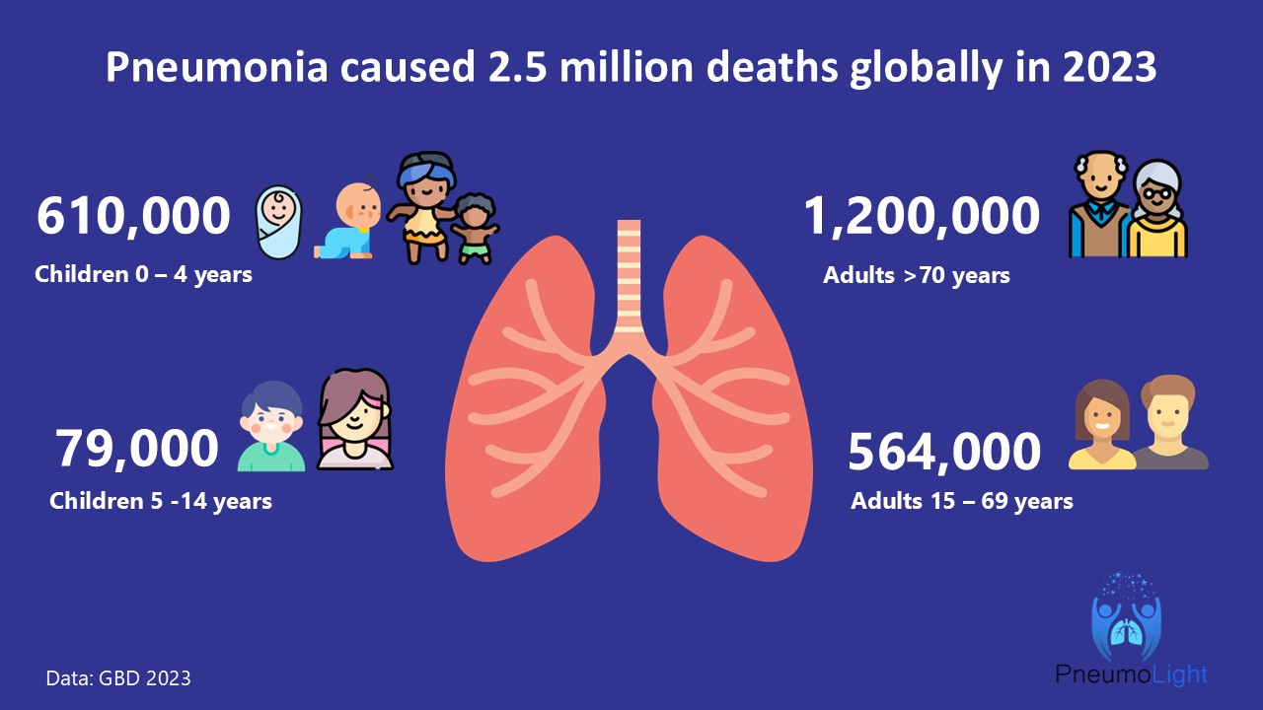
EPIDEMIOLOGY AND BURDEN
1 GBD 2023 Causes of Death Collaborators. Global burden of 292 causes of death in 204 countries and territories and 660 subnational locations, 1990-2023: a systematic analysis for the Global Burden of Disease Study 2023. Lancet 2025; 406: 1811–1872.

Slide 3
Burden in SSA
Accounts for 68% of all deaths causeed by pneumonia
Leading cause of death <5 yrs (then malaria 409,000, then diarrhoea 317,000) 52% occured in SSA
• High mortality due to:
ΗIV, Limited diagnostics, Delayed care, drug resistance
Tanzania Context
In 2018, tanzania among top 8 countries, 17,624 deaths under five years of age
CAP common cause of admission
Limited microbiological data
1 GBD 2023 Causes of Death Collaborators. Global burden of 292 causes of death in 204 countries and territories and 660 subnational locations, 1990-2023: a systematic analysis for the Global Burden of Disease Study 2023. Lancet 2025; 406: 1811–1872.
2. Miyayo, S.F.; Owili, P.O.; Muga, M.A.; Lin, T.-H. Analysis of Pneumonia Occurrence in Relation to Climate Change in Tanga, Tanzania. Int. J. Environ. Res. Public Health 2021, 18, 4731. https://doi.org/10.3390/ijerph18094731
Notes:
Pathogenesis of pneumonia.
4 Stages
1. Edema → 2. Red Hepatization (RBCs) → 3. Gray Hepatization (Neutrophils/Fibrin) → 4. Resolution (Macrophages).
Protective mechn.
Mechanical
- Nasal filtration - Cough reflex - Mucociliary clearance
Cellular
- Alveolar macrophages - Neutrophils
Humoral
- IgA, IgG - Complement - Surfactant proteins (SP-A, SP-D)

Slide 4
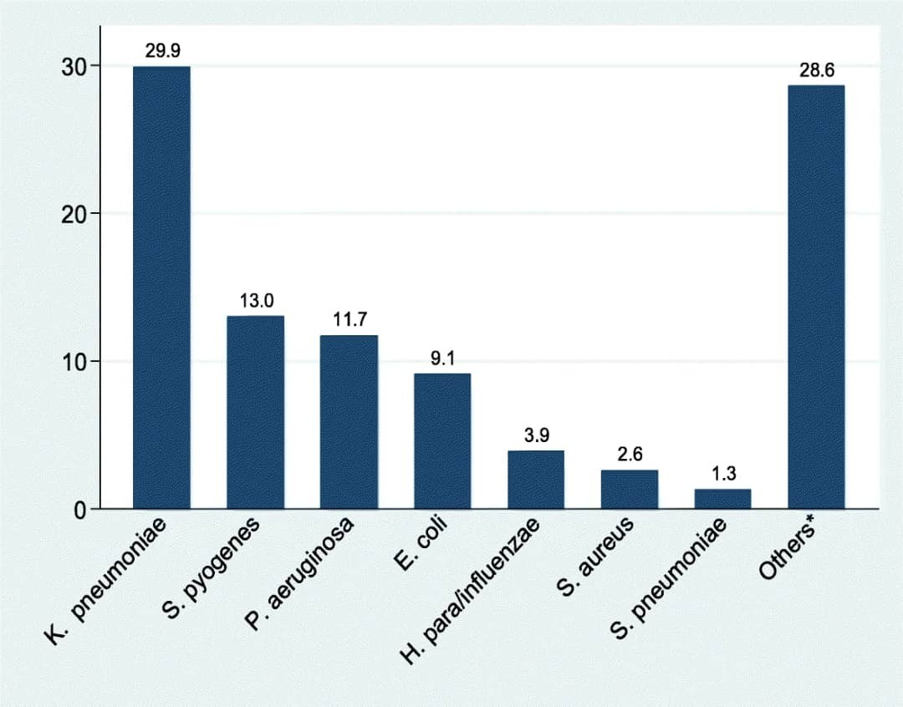
Distribution of causative agent and pattern of resistance
353 individuals sputum collected
Only 77 sputum was positive . of the 77
91% of K.pneumonia - resistant to amoxyxillin - clavulanic acid and 87.0% resistance to Ceftriaxone
E. Coli - 100% resistant to Ampicilin with 85.7 resistant to Ceftriaxone
All S. Aureus was susceptible to SXT
Prevalence of gram negative bacteria of causing community acquired pneumonia among adults in Mwanza City, Tanzania Peter Kishimbo1, Nyambura Moremi Sogone2, Fredrick Kalokola1 and Stephen E. Mshana3* 2020

Slide 5
Definition
An acute infection of the lung parenchyma (alveoli and interstitium), characterized by microbial invasion leading to inflammation, alveolar filling with exudate, and impaired gas exchange.
According to IDSA/ATS - Acute infection of the pulmonary parenchyma + new infiltrates on CXR + clinical features. Excludes
have recently completed foreign travel
immunocompromised individuals eg, HIV, suppress Cd4, post transplant, on chemo, immmunodeficiency, drug induced neutropenia.
According to WHO - Radiological Infiltrates not included
1. Diagnosis and Treatment of Adults with Community-acquired. Pneumonia An Official Clinical Practice Guideline of the American Thoracic Society and Infectious Diseases Society of America August 2019
Notes:
Pathogenesis of pneumonia.
4 Stages
1. Edema → 2. Red Hepatization (RBCs) → 3. Gray Hepatization (Neutrophils/Fibrin) → 4. Resolution (Macrophages).
Protective mechn.
Mechanical
- Nasal filtration - Cough reflex - Mucociliary clearance
Cellular
- Alveolar macrophages - Neutrophils
Humoral
- IgA, IgG - Complement - Surfactant proteins (SP-A, SP-D)

Slide 6
Classification of Pneumonia
Community-Acquired Pneumonia (CAP)
Subtypes:
Typical bacterial CAP
e.g. Streptococcus pneumoniae
Atypical CAP
e.g. Mycoplasma, Chlamydia, Legionella
Viral pneumonia
e.g. Influenza, SARS-CoV-2, RSV
Notes:
Infection acquired outside hospital or within <48 hours of admission
Atypical CAP- Bacteria that do not show up on standard Gram stains and inherently resist beta-lactam antibiotics.

Slide 7
CLASSIFICATION
Hospital-Acquired Pneumonia (HAP)
Develops ≥48 hours after hospital admission
Key features:
Often due to gram-negative bacilli or Staphylococcus aureus
Higher risk of multidrug resistance (MDR)
Ventilator-Associated Pneumonia (VAP)
Occurs ≥48 hours after endotracheal intubation
Characteristics:
Biofilm-related infection
Often MDR pathogens
High mortality
Notes:
Not incubating at admission
HAP- Also includes patients who present to the hospital with pneumonia but were discharged from a hospital within the last 7 to 10 days

Slide 8
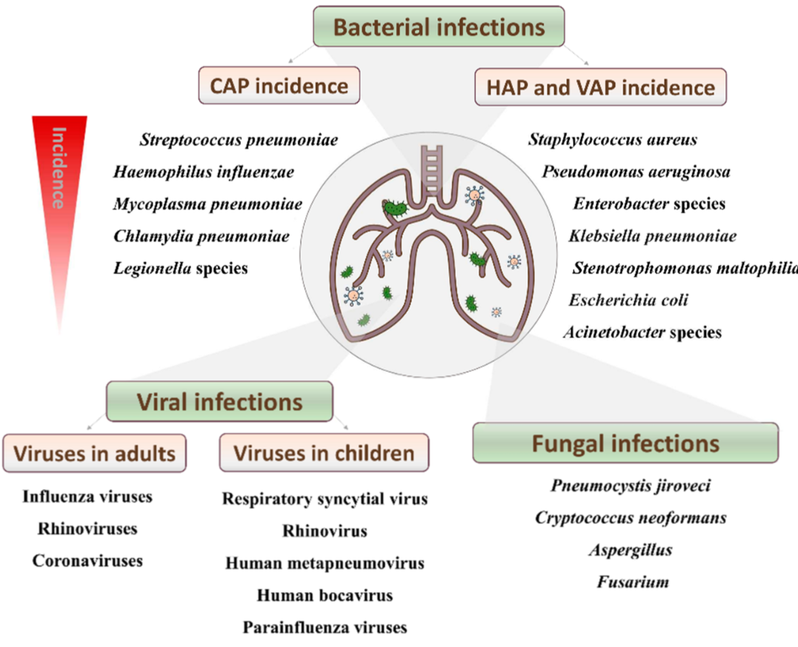
COMMON CAUSES
Notes:
Viral-bacterial codetection occurs in up to 30% of hospitalized adult CAP cases, dramatically increasing the risk of adverse outcomes and mortality

Slide 9
SYMPTOMS OF PNEUMONIA
Cough: The hallmark, can be Productive or Dry.
Fever, headache,
Respiratory-, dyspnea, pleuritic chest pain
Other: Fatigue, myalgias, loss of appetite.
Geriatrics - Confusion, no fever, sudden decline of function
Immunocompromised- minimal finding despite severe disease

Slide 10
SIGNS OF PNEUMONIA
Inspection: Nasal flaring, accessory muscle use. tachypnoeic
Palpation: Increased tactile fremitus, reduced chest expansion
Percussion: Dullness (Consolidation) or Stony dull (Effusion).
Auscultation: Bronchial breath sounds, Egophony ("E-to-A" sound), Crackles.

Slide 11
EXTRA PULMONARY SX-Atypical Pathogens
Legionella pneumophila
Hyponatremia (Na <130 mEq/L) due to SIADH.
Diarrhea (Watery, early).
Elevated CK and Bradycardia relative to fever.
Mycoplasma pneumoniae
Bullous Myringitis (painful blisters on tympanic membrane).
Cold Agglutinin Disease (Hemolytic anemia, acrocyanosis).
Erythema Multiforme / Stevens-Johnson overlap.

Slide 12
CLINICAL APPROACH
Cough + fever = infection. untill proven otherwise
exclude pneumonia mimics
Syndromic classification
Acute (<3 weeks) → pneumonia, PE
Subacute (3–8 weeks) → TB, atypical pneumonia
Chronic (>8 weeks) → TB, malignancy, HF
Notes:
depends on host factors
- HIV, COPD, diabetes, elderly, smoking

Slide 13
RED FLAGS
Hemoptysis (Coughing blood)
Dyspnea (Shortness of breath at rest)
Altered Mental Status (Hypoxia or Sepsis)
High Fever (>38.5°C, > 72 hours duration)
Hypotension (SBP < 90)
Hypoxia (SpO2 < 90% on room air)

Slide 14
DIFFERENTIALS/ MIMICS
CONDITION | KEY FEATURES
HEART FAILURE | Bil infiltrates, Orthopnea, PND Frothy sputum, volume overload signs No high-grade fever, CXR: cardiomegaly, pulmonary edema
TB | Chronic cough (>2–3 weeks) Low-grade fever, night sweats, weight loss Hemoptysis, Upper lobe involvement (CXR) Poor response to standard antibiotics
PE | Acute dyspnea + pleuritic chest pain +/- Mild fever, Hemoptysis Risk factors (immobility, surgery, cancer) Normal or subtle CXR
Lung Cancer | persistent opacity, weight loss, cough, obstructive symptoms
Notes:
GeneXpert / sputum AFB, Chest X-ray (cavitation, fibrosis)
In high TB burden settings → always rule out TB before labeling as CAP

Slide 15
SEVERETY ASSESSMENT
CURB -65
5 variable. (hospital)
CRB - 65 (Primary care)
PSI ( Pneumonia severity index)
Very accurate but complex (20 variables).
Used in tertiary setting
Notes:
PSI - Good for research, heavy for daily use
C- Confusion U-Urea R- resp rate >30 BP- <90 age >65

Slide 16
CURB 65
Parameters
Confusion = GCS <15
BUN >19mg/dl /7mmol/L
RR =/> 30 breaths/min
SBP <90mmHg /DBP <60 mmHg
Age =/ > 65 years
Adults are stratified for risk of death as follows
- 0 or 1: low risk (less than 3% mortality risk)
- 2: intermediate risk (3% to 15% mortality risk)
- 3 to 5: high risk (more than 15% mortality risk).

Slide 17
CURB-65 Limitations
- underestimate severity in young patient
- always combine with clinical judgment and Oxygenation
Hypoxia is a key ICU trigger.

Slide 18
Other severity assessment tools
SMART - COP
SBP <=90mmHg
Multilobar involvement on chest X ray
Albumin < 3.5g/dl
RR >/= 30/min
HR =/> 125bpm
Arterial Blood PH < 7.35
New confusion
O2 Saturation < 90%
NEWS2
RR
Sp02
SBP
HR
Level of consciousness
Temperature
+2 if on oxygen therapy

Slide 19
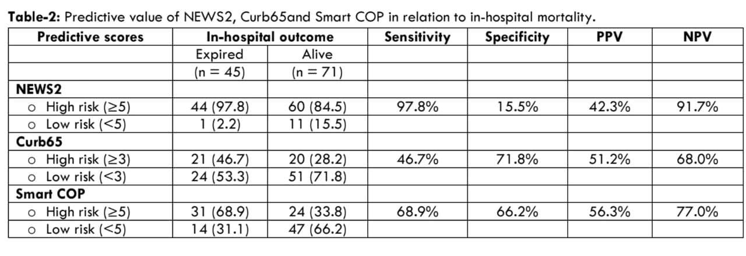
Sensitivity of CURB over other severity assessment tools
Barry, AA., Kumari, N., et al., 2025. Advanced Pneumonia Prognostication: Superior Performance of NEWS2 over CURB-65 and SMART-COP. Medical Research Archives, [online] 13(8). https://doi.org/10.18103/mra.v13i8.6687 European Society of Medicine 14th August 2025

Slide 20
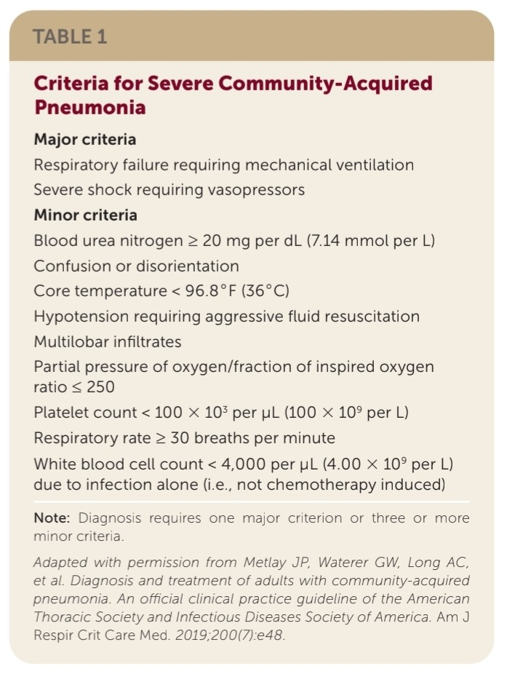

Slide 21
Labs workup
TEST | ROLE | EVIDENCE/GUIDELINE
FBP | neutrophilia, lymphocytosis | non specific but routine
CRP | Inflammatory marker
Procalcitonin | bacteria vs viral | ATS 2025
Urea | severity | strong prognostic value
HIV | Risk stratification | WHO recomendations
ABG | Severity
RBG | Risk stratification
Notes:
Bacterial Endotoxins (IL-1b, TNF-a): STIMULATE PCT release from parenchymal cells.
Viral Infection (Interferon-Gamma): SUPPRESSES the CALC-1 gene (PCT gene).
Clinical Correlate:
viral infection Lab: PCT <0.25, CRP high.
Baseline Bloods: electrolytes, liver function tests,
ProACT Trial (2018)
Procalcitonin-guided therapy
→ Reduced antibiotic use, no mortality difference

Slide 22
MICROBIOLOGY
TEST | INDICATION | EVIDENCE
Sputum gram stain | moderate- severe CAP | low sensitive, useful when +ve
Sputum culture | Severe or non responding pneumonia | helps target therapy
Blood culture | severe CAP/ ICU | recomended before antibiotics
urinary antigen | Legionella/ pneumococcus | rapid diagnosis
Multiplex PCR | Viral and atypical | MULTI-CAP Trial 2025
Notes:
- pneumococcal urinary antigen tests to support de-escalation to a narrower_x0002_spectrum antibiotic
- legionella urinary antigen tests if the person has risk factors for legionella infection

Slide 23
IMAGING
1. Chest X-Ray.
- gold standard initial test
- confirm diagnosis - within 4 hours of admission
2. Lung Ultrasound
- Real-time bedside tool (ICU/emergency)
- Possible alternative diagnosis Eg HF
3. Chest CT
- Complications or unclear cases
Notes:
CXR- insensitive in dehydration and early disease.

Slide 24
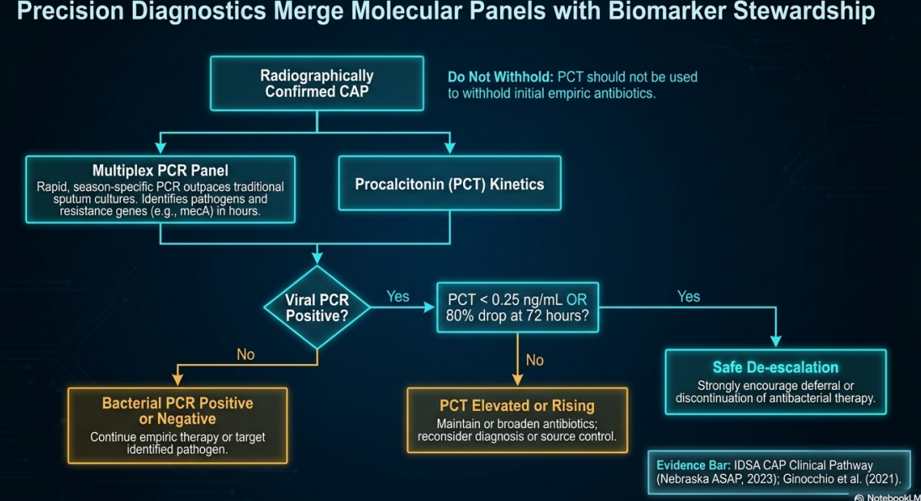
Notes:
Guiding Initiation and Cessation
Initiation:
PCT <0.10 µg/L: Strongly discourages antibiotic initiation.
PCT >0.25 µg/L: Suggests bacterial infection.
Cessation (The Stewardship Tool):
Criteria: PCT <0.25 µg/L OR >80% drop from peak.
Action: STOP ANTIBIOTICS.
Primary driver for the "Shorter is Safer" paradigm

Slide 25
PRINCIPLES OF MANAGEMENT
Resuscitate: Oxygen for SpO2 < 92%. Fluids for shock.
Treat: Antibiotics (Empiric, then Targeted).
Monitor: Clinical stability (Temp, HR, RR, BP, O2).
Prevent: Vaccines, mobilize, swallow assessment.
Notes:
Severity assessment tools (PSI, CRB65/CURB65) to determine site of care and mortality risk
Early diagnostics (CXR) and microbiology in moderate–severe or HAP; start antibiotics ≤4 hours
Empiric antibiotics tailored to CAP vs HAP, severity, local AMR; de‑escalate by cultures
Supportive care: oxygen/HFNO, NIV/intubation as needed; cautious fluids, early nutrition and mobilization
Prevention: PCV20/21 or PCV15→PPSV23, influenza/COVID/RSV vaccines, smoking cessation, ventilator bundles and hand hygiene

Slide 26
Antibiotic treatment for CAP
severity of symptoms or signs, based on clinical judgement and CURB-65 score
risk of developing complications, Eg relevant comorbidity such as severe lung disease or immunosuppression
local antimicrobial resistance
recent antibiotic use
recent microbiological results, i.e colonisation with MDR
Notes:
IV to Oral Switch: Review IV antibiotics at 48 hours; step down to oral therapy as soon as clinical stability is achieved.

Slide 27
Empiric Therapeutics: Outpatient CAP
Low-Risk (No Comorbidities):
Therapy: Amoxicillin 1g TID OR
Doxycycline 200mg stat then 100mg od 4/7
Note: Macrolide monotherapy failing due to >30% S. pneumoniae resistance in US.
Notes:
alternative oral antibiotics for penicillin allergy or if
amoxicillin unsuitable (for example, if atypical pathogens suspected)

Slide 28
Inpatient CAP (Moderate Severity)
First-Line Options:
Oral Amoxicillin 500 mg TDS for 5 days.
Add Clarithromycin 500 mg BD if atypical pathogens are suspected.
Alternatives (Penicillin Allergy):
Doxycycline OR Clarithromycin monotherapy.
Note on Fluoroquinolones: Avoid routine use due to MHRA/FDA warnings regarding long-lasting adverse effects; use only when other standard antibiotics are inappropriate.
Notes:
FDA (Black Box Warning): The FDA has also strengthened warnings regarding tendinitis, tendon rupture, peripheral neuropathy, and central nervous system (CNS) effects.
Situations for Use: 1. when standard first-line antibiotics have failed due to resistance, 2. contraindicated for the patient, 3. caused side effects requiring treatment cessation

Slide 29
High-severity disease CAP
first line antibiotics
Co-amoxiclav:
500/125 mg three times a day orally or 1.2 g three
times a day intravenously for 5 days
PLUS
Clarithromycin 500 mg BID PO or intravenously for 5 days
Or
Erythromycin (in pregnancy): 500 mg four times a day PO for 5 days

Slide 30
..
alternative antibiotic for penicillin allergy
Levofloxacin 750 mg once daily 5/7
or
Levofloxacin 500mg bd 5/7

Slide 31
Management of Hospital-Acquired Pneumonia (HAP)
Early HAP (<5 days post-admission, no high-risk factors)
First-line: Oral Co-amoxiclav for 5 days, then review.
Late/Severe HAP or High Risk of Resistance
Requires broad-spectrum IV therapy based on local data.
Options: Piperacillin-tazobactam, Ceftazidime, or Meropenem.
MRSA Suspected: Add dual therapy with IV Vancomycin ,Teicoplanin or Linezolid
Notes:
linezolid 600 mg twice a day orally or intravenously
Teicoplanin:
Initially 6 mg/kg every 12 hours for 3 doses, then 6 mg/kg
once a day intravenously

Slide 32
Managing Viral Pneumonia & Antibiotic Stewardship
Outpatients with a Positive Viral Test
No Comorbidities: It is suggested to WITHHOLD empiric antibiotics due to a low risk of bacterial coinfection.
With Comorbidities: Prescribe antibiotics due to the high risk of severe outcomes from missed coinfections.
Inpatients WITH a Positive Viral Test
Prescribe empiric antibiotics universally, as the risk and mortality associated with viral-bacterial coinfection in hospitalized patients are very high.

Slide 33
Adjunctive Therapy: Corticosteroids in CAP
Nonsevere CAP
Strongly recommended AGAINST. Do not administer systemic corticosteroids, as the risk of hyperglycemia and secondary infections outweighs any benefit.
Severe CAP
Systemic corticosteroids are suggested (conditional recommendation), as they have been shown to reduce time in ICU and mortality.
Protocol: Consider IV Hydrocortisone (or Dexamethasone) for 4 to 7 days.
Exception: Do NOT use steroids if the severe CAP is caused by Influenza pneumonia.
Notes:
CAPE COD Trial (2023, NEJM)
Steroids in severe CAP
→ Reduced mortality with hydrocortisone in ICU patients

Slide 34
Non-Invasive Respiratory Support
Targeting Oxygenation: Standard oxygen therapy is the first line to maintain SpO2 > 94% (or 88-92% in chronic retainers).
High-Flow Nasal Oxygen (HFNO): If standard oxygen is insufficient, consider a trial of HFNO. It is generally better tolerated and less invasive than CPAP.
CPAP/NIV: Consider specifically for patients with coexisting conditions that benefit from positive pressure, such as COPD exacerbations (Type 2 respiratory failure) or concurrent heart failure (acute pulmonary edema).

Slide 35
The Non-Responding Patient
Reassessment Criteria: Review the patient if symptoms fail to improve after 3 days, worsen rapidly, or systemic instability occurs.
Action Plan:
Repeat CRP/Procalcitonin to gauge biological response.
Send new microbiological samples (sputum/blood).
Broaden antibiotic coverage if resistant organisms are suspected
Investigate for alternative diagnoses (e.g., TB, lung cancer) or complications (e.g., empyema).

Slide 36
Pregnancy & Immunocompromised
PREGNANCY
Avoid Tetracyclines (Doxycycline) and standard Fluoroquinolones.
If a macrolide is necessary (e.g., severe penicillin allergy), Erythromycin is the preferred safe option.
HIV/AIDS with PCP
Steroid is mandatory
Indication: Room air PaO2 <70 mmHg OR A-a gradient >35.
Timing: Steroids must be started before or concurrent with antibiotics

Slide 37
Complications: Local Pulmonary Issues
Parapneumonic Effusion: Fluid accumulation in the pleural space. Usually sterile and resolves with antibiotics, but requires monitoring
Empyema: Infection of the pleural fluid (pus).
Signs: Persistent swinging fevers despite antibiotics, elevated CRP, dullness to percussion.
Management: Requires urgent pleural fluid aspiration, drainage via chest tube, and prolonged IV antibiotics.
Lung Abscess/Necrotizing Pneumonia: Often associated with S. aureus or Klebsiella; requires extended courses of tailored antibiotics.

Slide 38
Management of Parapneumonic Effusions
Uncomplicated Effusion
Exudate, normal pH >7.30, normal glucose.
Management: Antibiotics only. Do NOT place a chest tube.
Complicated Effusion
Criteria: pH <7.20, Glucose <60 mg/dL, LDH >1000.
Management: Chest Tube Drainage.
Notes:
LIGHTS CRITERIA
INDICATIONS OF CHEST TUBE DRAINAGE
. empyema, +ve gram stain/culture, loculated
. large symptomatic- significant dyspnea
. mediastinal shift / lung collapse
. hemothorax, rec malign symptomatic effusion
. before pleurodesis

Slide 39
Managing Progression - Empyema
Definition: Frank pus OR positive Gram stain/culture of pleural fluid.
Physiology: Fibrin deposition leads to loculation and trapped lung.
Advanced Intervention (MIST2 Trial Protocol):
Drainage: Large-bore chest tube (or surgical VATS).
Therapy: Intrapleural tPA + DNase improves drainage and reduces surgical referral rates.

Slide 40
Systemic Complications
Sepsis and Septic Shock: Progression of the localized infection to a dysregulated systemic response, causing profound hypotension and organ failure. Requires aggressive fluid resuscitation and vasopressors.
ARDS (Acute Respiratory Distress Syndrome): Diffuse alveolar damage resulting in severe, refractory hypoxemia and bilateral opacities on imaging. Frequently necessitates intubation and protective mechanical ventilation.

Slide 41
Prevention Strategies: Vaccination
Pneumococcal Vaccines: Crucial for high-risk groups (elderly, diabetics, chronic lung disease, HIV+ patients) to prevent invasive pneumococcal disease.
Influenza Vaccine: Annual vaccination reduces the risk of primary viral pneumonia and the devastating secondary bacterial coinfections associated with the flu.
Smoking Cessation & Air Quality: Addressing indoor air pollution and smoking can significantly decrease baseline susceptibility to lower respiratory tract infections.
Notes:
PCV20 / PCV21 (Prevnar 20 / Capvaxive):
Mechanism: Conjugate vaccines targeting capsular polysaccharides.
Impact: Covers >80% of invasive serotypes in adults. Reduces nasopharyngeal carriage (herd immunity).
Schedule Simplification: Eliminates need for PPSV23 boosters in many adult protocols.

Slide 42
CASE 1
45-year-old male, hotel worker
C/C: Confusion + diarrhea + fever (3 days)
High-grade fever (39.5°C), mild Dry cough, Watery diarrhea, Headache, confusion, No TB symptoms
On Exam. Temp: 39°C, BP: 95/60 RR: 26 SpO₂: 92% RA
Chest: mild crackles
Initial Labs. Na⁺: 128 mmol/L CRP: 105 LFTs: mildly elevated
Diagnosis..?
Confirmatory Tests..??
Urinary antigen (Legionella), PCR (if available)
Management..?
Notes:
Extrapulmonary dominant (GI + CNS) Atypical pneumonia
Hyponatremia → classic for Legionella
Mild chest signs but sick patient
Azithromycin OR Levofloxacin
Admit (moderate–severe)

Slide 43
CASE 2
38-year-old female C/C: Sudden SOB + mild fever
Acute onset dyspnea 2 Hr a/w Pleuritic chest pain. Non productive cough
Recent travel 10-hour bus trip
On Exam, RR: 33 HR: 115 SpO₂: 90% RA T- 37.9
Chest: clear
CXR: Normal CRP: 22
DDX
Pulmonary Embolism (Pneumonia mimic)
Next Steps
D-dimer, CT Pulmonary Angiography
“Not all fever + SOB is pneumonia — always rule out PE
Notes:
Sudden onset, Clear chest exam, Normal CXR
Risk factor (immobility)
Fever can occur in PE
Tachypnea + hypoxia overlap with pneumonia

Slide 44
CASE 3
58-year-old male, diabetic
4 days hx fever, productive cough, dyspnea
12 hrs hx confusion + lethargy
O/E. Temp 39.8°C, HR 130, BP 80/50 (MAP 60)
RR 34, SpO₂ 84% RA, GCS 14(confused)
Accessory muscle use, RLL crackles
Mottled skin, delayed capillary refill
CXR: Multilobar pneumonia
RLL consolidation
LUL patchy infiltrates
WBC 32,000, bands 15%
Platelets 85,000
BUN 32, Cr 1.9 (AKI)
Lactate 4.2 mmol/L
CRP 320, PCT >10
ABG: PaO₂/FiO₂ = 165 (hypoxemia)
DX- Severe CAP with septic shock + hypoxemic respiratory failure

Slide 45
Questions.
Severity & ICU Need.?
Antibiotic Appropriateness.?
Resuscitation & Monitoring.?
Adjunctive Corticosteroids needed.?
Non-Responder at Day 3. what to do next
Notes:
1. Meets ATS Severe CAP criteria
Major: Septic shock. Minor ≥3: RR>30, PF<250, confusion, BUN↑, thrombocytopenia, multilobar
👉 ICU admission required
2. Recent hospitalization (2 months ago), Recent IV antibiotic use, Diabetes mellitus
Recommended Escalation: Piperacillin–Tazobactam ± MRSA coverage (Vancomycin/Linezolid)
3. Persistent lactate → ongoing septic shock
Start Norepinephrine (target MAP ≥65)
Monitor urine output, vitals, repeat lactate
4. IV Hydrocortisone 200 mg/day (4–7 days)
Avoid if influenza suspected
5. Think of 5 M’s”:
Microbe: Resistant organism → broaden Abx
Mechanical: Effusion, abscess → imaging + drainage
Masquerader: PE, malignancy
Medication: Drug failure
Metabolic: Aspiration
👉 CT chest, cultures, ± bronchoscopy

Slide 46
References.
Metlay, J.P., Waterer, G.W., Long, A.C., et al. (2019) Diagnosis and treatment of adults with community-acquired pneumonia. American Journal of Respiratory and Critical Care Medicine, 200(7), pp. e45–e67.
World Health Organization (2023) Integrated Management of Adolescent and Adult Illness (IMAI): District clinician manual. Geneva: WHO.
National Institute for Health and Care Excellence (NICE) (2019) Pneumonia (community-acquired): antimicrobial prescribing (NG138). London: NICE.
Evans, L., Rhodes, A., Alhazzani, W., et al. (2021) Surviving Sepsis Campaign: international guidelines for management of sepsis and septic shock 2021. Intensive Care Medicine, 47, pp. 1181–1247

Slide 47
..
Bielicki, J.A., Stöhr, W., Barratt, S., et al. (2021) Effect of amoxicillin dose and duration on outcomes in children with community-acquired pneumonia (CAP-IT). JAMA, 326(17), pp. 1713–1724.
Huang, D.T., Yealy, D.M., Filbin, M.R., et al. (2018) Procalcitonin-guided use of antibiotics for lower respiratory tract infection (ProACT Trial). New England Journal of Medicine, 379, pp. 236–249.
Rahman, N.M., Maskell, N.A., West, A., et al. (2011) Intrapleural use of tissue plasminogen activator and DNase in pleural infection (MIST2). New England Journal of Medicine, 365, pp. 518–526.
Dequin, P.F., Meziani, F., Quenot, J.P., et al. (2023) Hydrocortisone in severe community-acquired pneumonia (CAPE COD Trial). New England Journal of Medicine, 388, pp. 1931–1941.
Frat, J.P., Thille, A.W., Mercat, A., et al. (2015) High-flow oxygen through nasal cannula in acute hypoxemic respiratory failure (FLORALI Trial). New England Journal of Medicine, 372, pp. 2185–2196.

Slide 48

.

